Slide 1
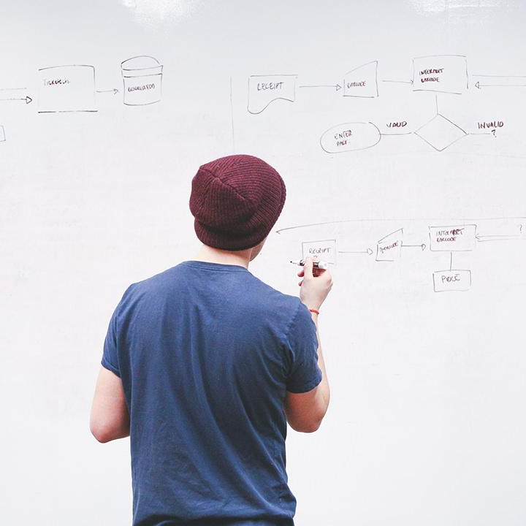
HELLO!
Here 1Crore Projects
I am here because I love to give presentations.
You can find me at @1CROREPROJECTS

Slide 2
ONLINE BIDDING WEBSITE

Slide 3

AIM OF PROJECT
The main aim of this project is to design an audio mp3 player that can be suitable for different level of users

Slide 4
ABSTRACT
The traditional biding system does not meet the social development now. Along with the quick development of the Internet, the online biding system should be developed. This thesis focuses on analyzing how to design a secure online biding system. This system is designed for users who can release biding information, upload or download mark book and query medium mark information

Slide 5
INTRODUCTION
Bidding because of its open, fair, impartial and competitive features, optimizing the function, making its impact and scope of application expanded. In order to standardize the bidding behavior and promote fair competition, "The People's Republic of China Public Bidding," Since January 1, 2000 come into force. Future infrastructure, public utilities, the use of state and national fiancé capital investment projects and related to the procurement of major equipment and materials to reach a certain size, must be tender
A WEB-based bidding system for the tender side release news, tender uploading and downloading the purpose of bidding as a network platform to improve efficiency and transparency of the bidding

Slide 6
EXISTING SYSTEM
The present systems are platform dependent and these plug-in services are not suitable for all types of applications and devices. Often, these systems have difficulties in managing the files and play lists.

Slide 7
DISADVANTAGES:
Less security.
Data privacy.

Slide 8
PROPOSED SYSTEM
This mp3 player has inbuilt ID3 tag editor. The benefits of the system are: It is a fast standalone mp3 player Facility to save play-list files ID3 tag editor to edit mp3 metadata. The system can be easily integrated into other applications and devices. The system supports features which are platform independent.

Slide 9
ADVANTAGES:
High security
It takes less time.

Slide 10
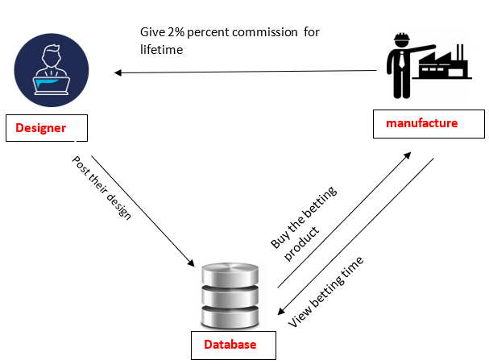
SYSTEM ARCHITECTURE

Slide 11
MODULES
In this project has two modules
Designer
manufactures

Slide 12
MODULES DESCRIPTIONS:
Designer :
Register the account with basic information
Login the account with correct username and password
Designer can post their design on the website and they also fix the date and time (But date and time is not real)allowed by this the betting can be held for manufactures.
Designer can conduct the betting for manufactures. and who have highest Bett they can buy the designs.
If manufacture will sale the betting product and they want to give 2% commission to the designer for the lifetime.
Logout

Slide 13
Manufactures:
Register the account with basic information
Login the account with correct username and password.
manufactures can view the betting date and time on the website
manufactures can buy the betting product on the website and he want give 2% commission to the designer for the lifetime.
Logout

Slide 14
SOFTWARE REQUIREMENTS
Operating system : Windows 7/10.
Coding Language : JAVA
Data Base : MYSQL
IDE : NetBeans

Slide 15
HARDWARE REQUIREMENTS
System : Intel i3.
Hard Disk : 40 GB.
Monitor : 15 VGA Colour.
Mouse : Logitech.
Ram : 4 GB.

Slide 16
FUTURE WORK
In our future work , We implement the system left interface, to facilitate future evaluation function added.

Slide 17
CONCLUSION
The system uses Internet as a platform to provide a convenient platform for bidding, the bidding quickly transfer information. Compared with the previous traditional tender, online tender bidding can save the time, manpower, material resources, so tender and bidding platform both organically through this link, but also to a certain extent, improve the transparency of the tender, to prevent improper The emergence of competition. With the regularization of the bidding, the people of conceptual change, market demand, online bidding platform and evaluation system has been gaining popularity and attention.

Slide 18
REFERENCE
[1] Xi Jianghua. ASP.NET2.0 Developing Detail Explain - using C # Best Practice Guide. Beijing: Electronic Industry Press, 2006.11
[2] Gang. ASP.NET2.0 Development Guide. Beijing: Posts & Telecom Publishing, 2006.5
[3] Russ Basiura Richard Conway waiting, Xiao-na, yellow branching translation. ASP.NET safe level programming. Beijing: Tsinghua University Press, 2003.4

Slide 19
THANKS!
Any questions?
You can find me at
Reach us – 1croreprojects@gmail.com
Contact / Whatsapp: 7708 150 152 / 9751 800 789 / 790 432 0834

